Slide 1
CGB1201 – JAVA PROGRAMMING
Department of Artificial Intelligence and Data Science
Academic Year: 2024 – 2025 (Odd Semester)
Register Number : 2303811724322089
Name : REXCIA A
Year : II
Semester : III
Section : B
Date : 03-12-2024

Slide 2
Title of the Project
Visitor Management System

Slide 3
Problem Identification
Visitor Management Systems often encounter issues such as security lapses, inefficient manual processes, and inaccurate data entry. These problems can result in unauthorized access, extended check-in times, and compromised visitor information.Improved data encryption and compliance with privacy regulations safeguard sensitive information, while reporting and analytics tools enable organizations to make informed decisions and optimize visitor management practices.

Slide 4
Objective
Enhance Security: Ensure only authorized visitors can enter the facility by maintaining accurate visitor records.
Automate Processes: Streamline visitor registration, check-ins, and check-outs to reduce manual work and human errors.
Improve Visitor Experience: Provide a smooth and efficient check-in process, including pre-registration options.
Real-Time Monitoring: Enable real-time tracking of visitors for better facility management and security

Slide 5
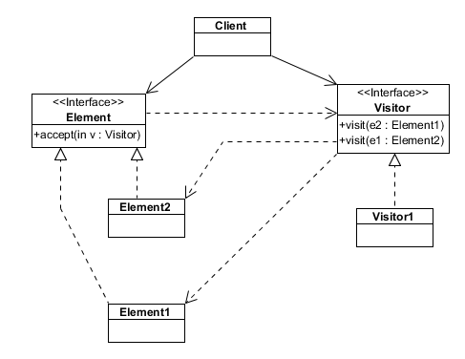
Proposed Architecture

Slide 6
Java Programming - Concepts Used
Classes and Objects: The program uses classes to represent visitors and the management system.
Methods: Various methods are implemented to handle visitor registration, check-out, and information display.
User Input Handling: The program uses the Scanner class to handle user inputs.
Date and Time Management: The LocalDateTime class is used to record check-in and check-out times
Authorization: A simple password-based authorization mechanism is implemented for accessing sensitive information.

Slide 7
List of Modules
Visitor Registration Module
Check-in and Check-out Module
Visitor Authentication and Security Module
Reporting and Analytics Module

Slide 8
Module Description
Visitor Registration Module : The Visitor Registration Module handles the initial interaction with visitors, capturing their details before they enter the facility. This module supports both pre-registered and walk-in visitors.
Check-in and Check-out Module : This module automates the process of logging visitors as they enter and leave the facility, ensuring accurate tracking and reducing manual efforts.
Visitor Authentication and Security Module : This module ensures that only authorized individuals gain access to the facility by verifying visitor credentials and integrating with security systems.
Reporting and Analytics Module : The Reporting and Analytics Module provides tools for generating detailed reports and analyzing visitor data to support operational decisions and compliance.

Slide 9
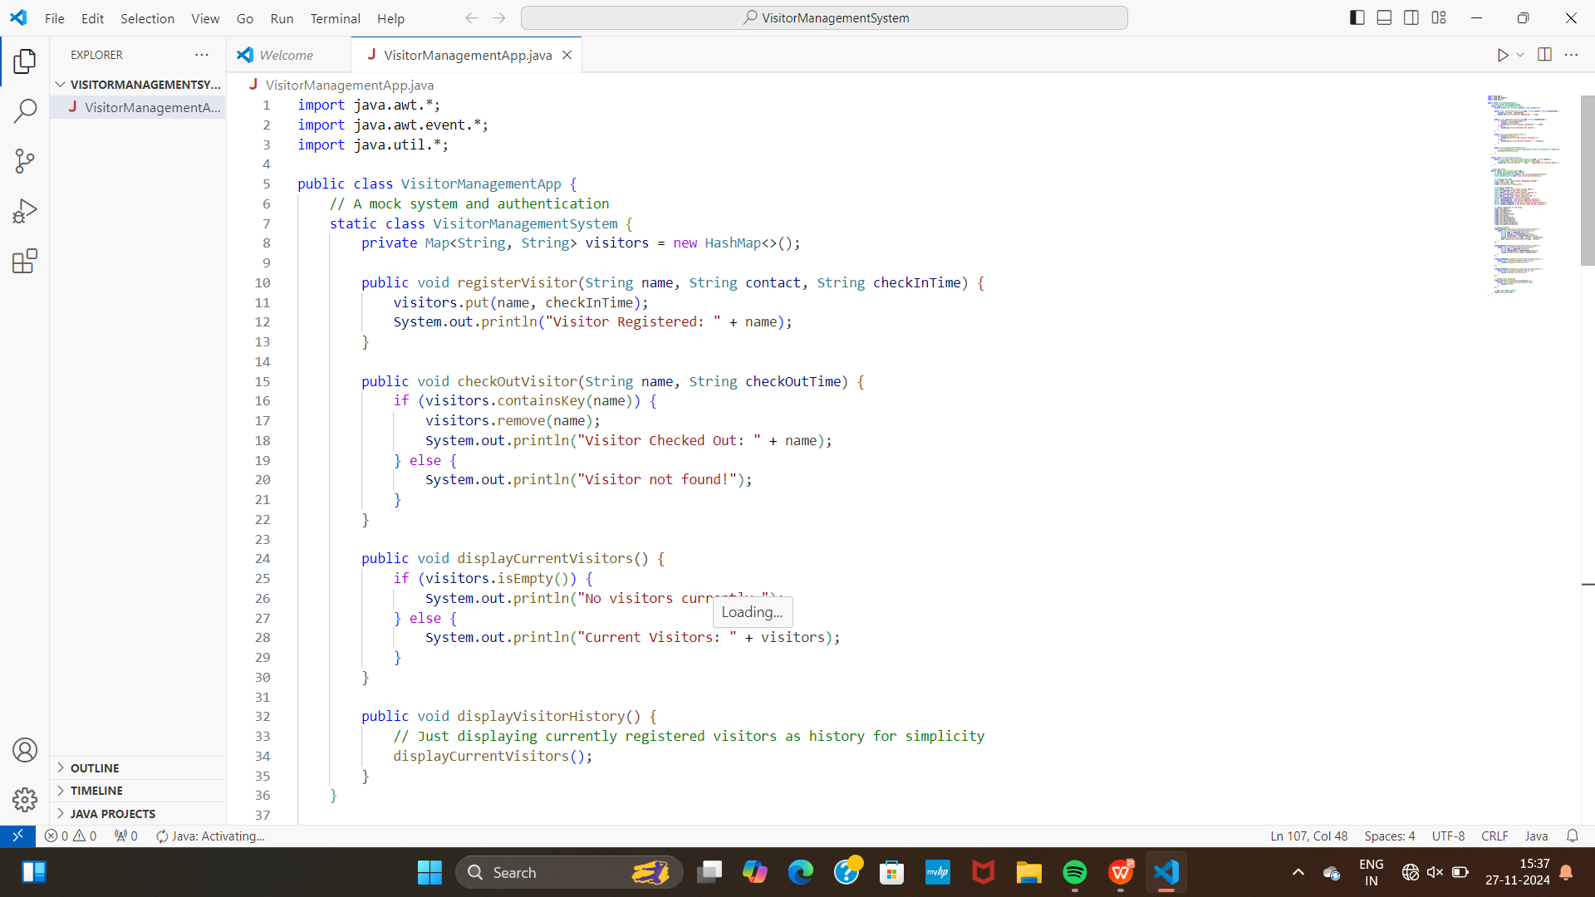
Source Code

Slide 10
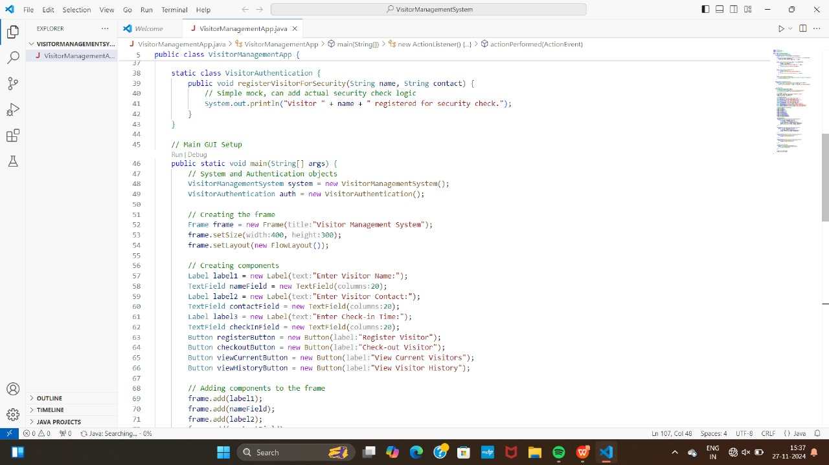
Source Code

Slide 11
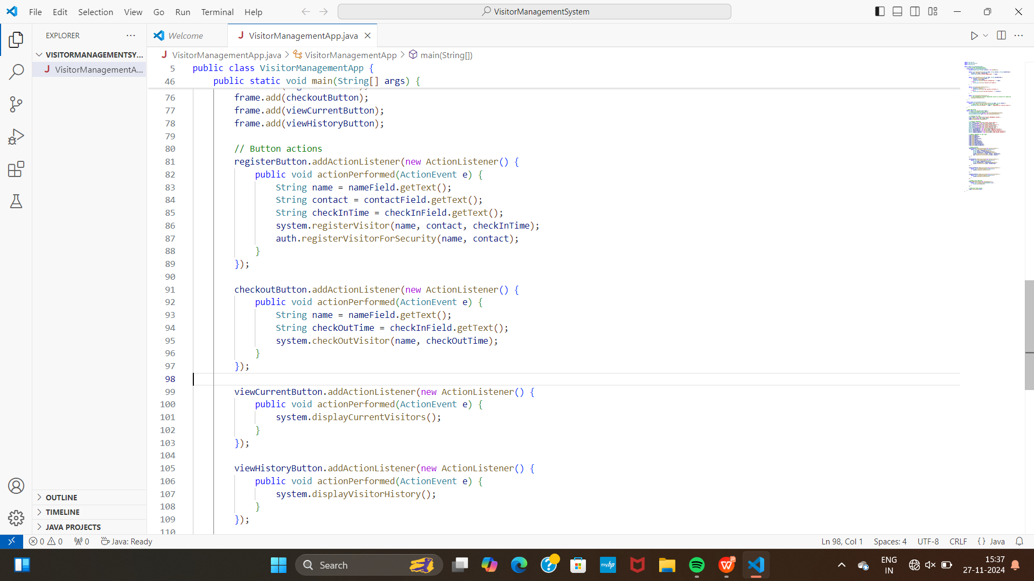
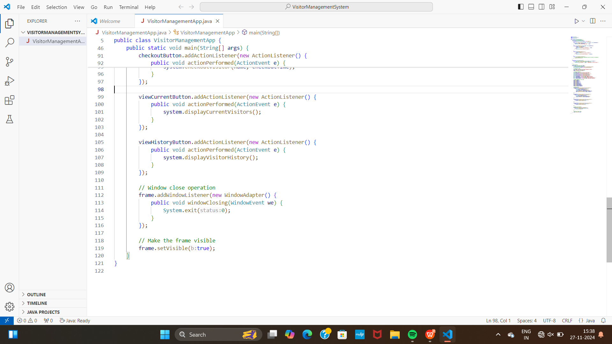
Source Code

Slide 12
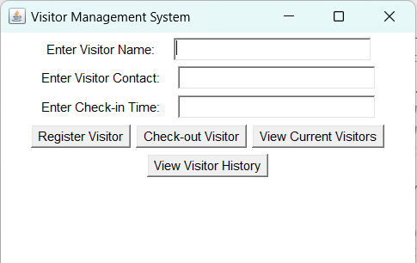
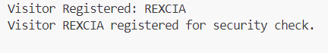
OUTPUT

Slide 13
Results
The Visitor Management System successfully manages visitor information, allowing for efficient registration, check-in, and check-out processes. The system's modular design ensures easy maintenance and scalability. The authorization mechanism provides an additional layer of security for accessing sensitive information.

Slide 14
Conclusion
The Java-based Visitor Management System is an effective solution for managing visitor information. It leverages key Java programming concepts to provide a functional and secure application. Future enhancements could include a graphical user interface and integration with external databases for improved data management.

Slide 15
Thank You
Any queries???

